Slide 1

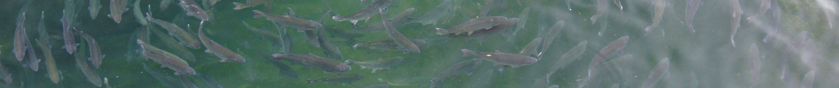
Mixed-effects models of growth using tag-recapture-age data
¹Darcy Webber and ²James Thorson
¹Quantifish
²NOAA, Seattle, Washington
Notes:
This is something I’ve been working on with Jim Thorson, a quantitative fisheries scientist at NOAA.
So we intend for this work to form a methodology paper, we will include the code for doing such an analysis in the appendix and on github. It could also be submitted elsewhere at a later date with a more in depth application to Antarctic toothfish. But for now we are just using toothfish as the data required to attempt such an analysis is really hard to come by.

Slide 2



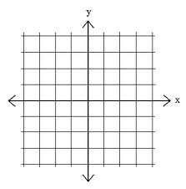
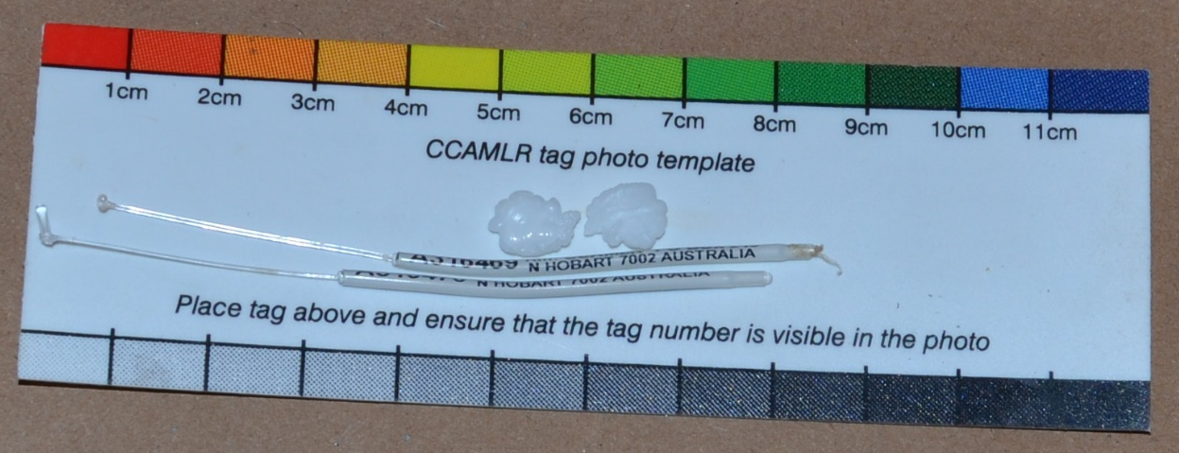
Outline
Individual-level variability
Temporal variability
Seasonal variability
Spatial variability (horizontal)
Simulation and model validation
Notes:
1. So the things we wanted to look at included…

Slide 3
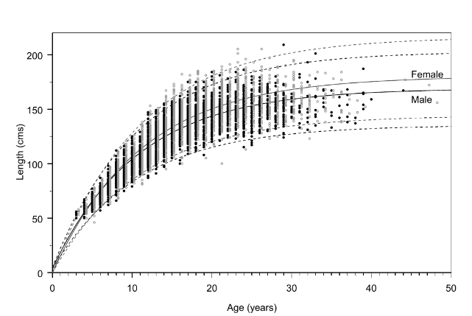
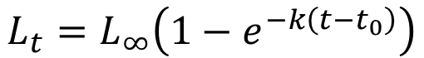
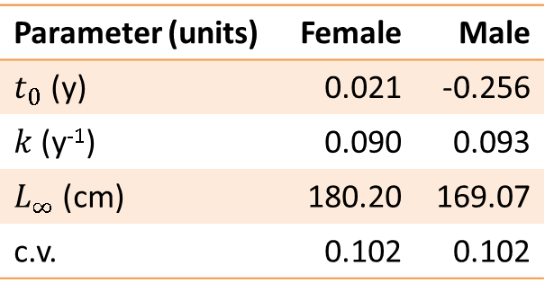
Current model: age-length data
$$L_{t}=L_{∞}\left(1−e^{−k\left(t−t_{0}\right)}\right)$$
Parameter (units) | Female | Male
$t_{0}$ (y) | 0.021 | -0.256
$k$ (y⁻¹) | 0.090 | 0.093
$L_{∞}$ (cm) | 180.20 | 169.07
c.v. | 0.102 | 0.102
Dunn, A., Horn, P.L., Hanchet, S.M. (2006). Revised estimates of the biological parameters for Antarctic toothfish (Dissostichus mawsoni) in the Ross Sea. WG-FSA-SAM-06/8.

Slide 4
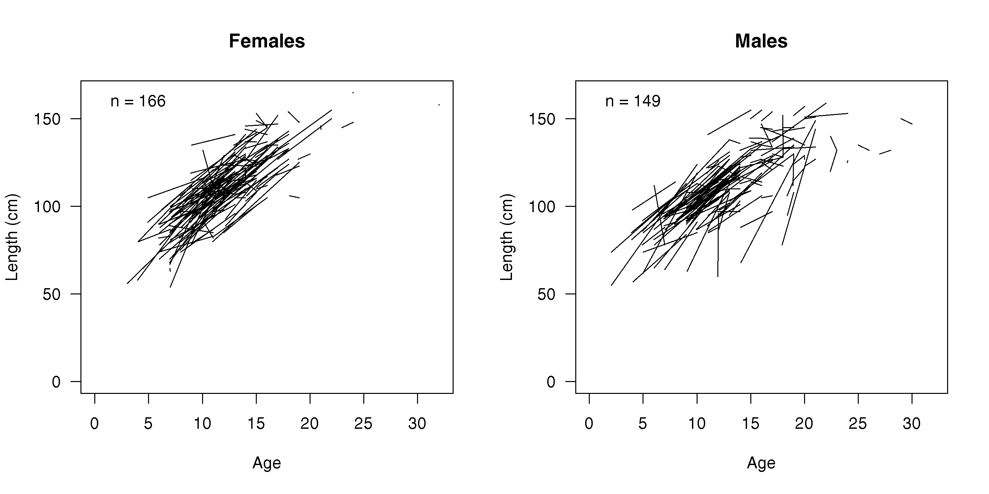
Tag-recapture-age data
Antarctic toothfish (Dissostichus mawsoni) tag-recapture data where fish were aged after recapture.

Slide 5
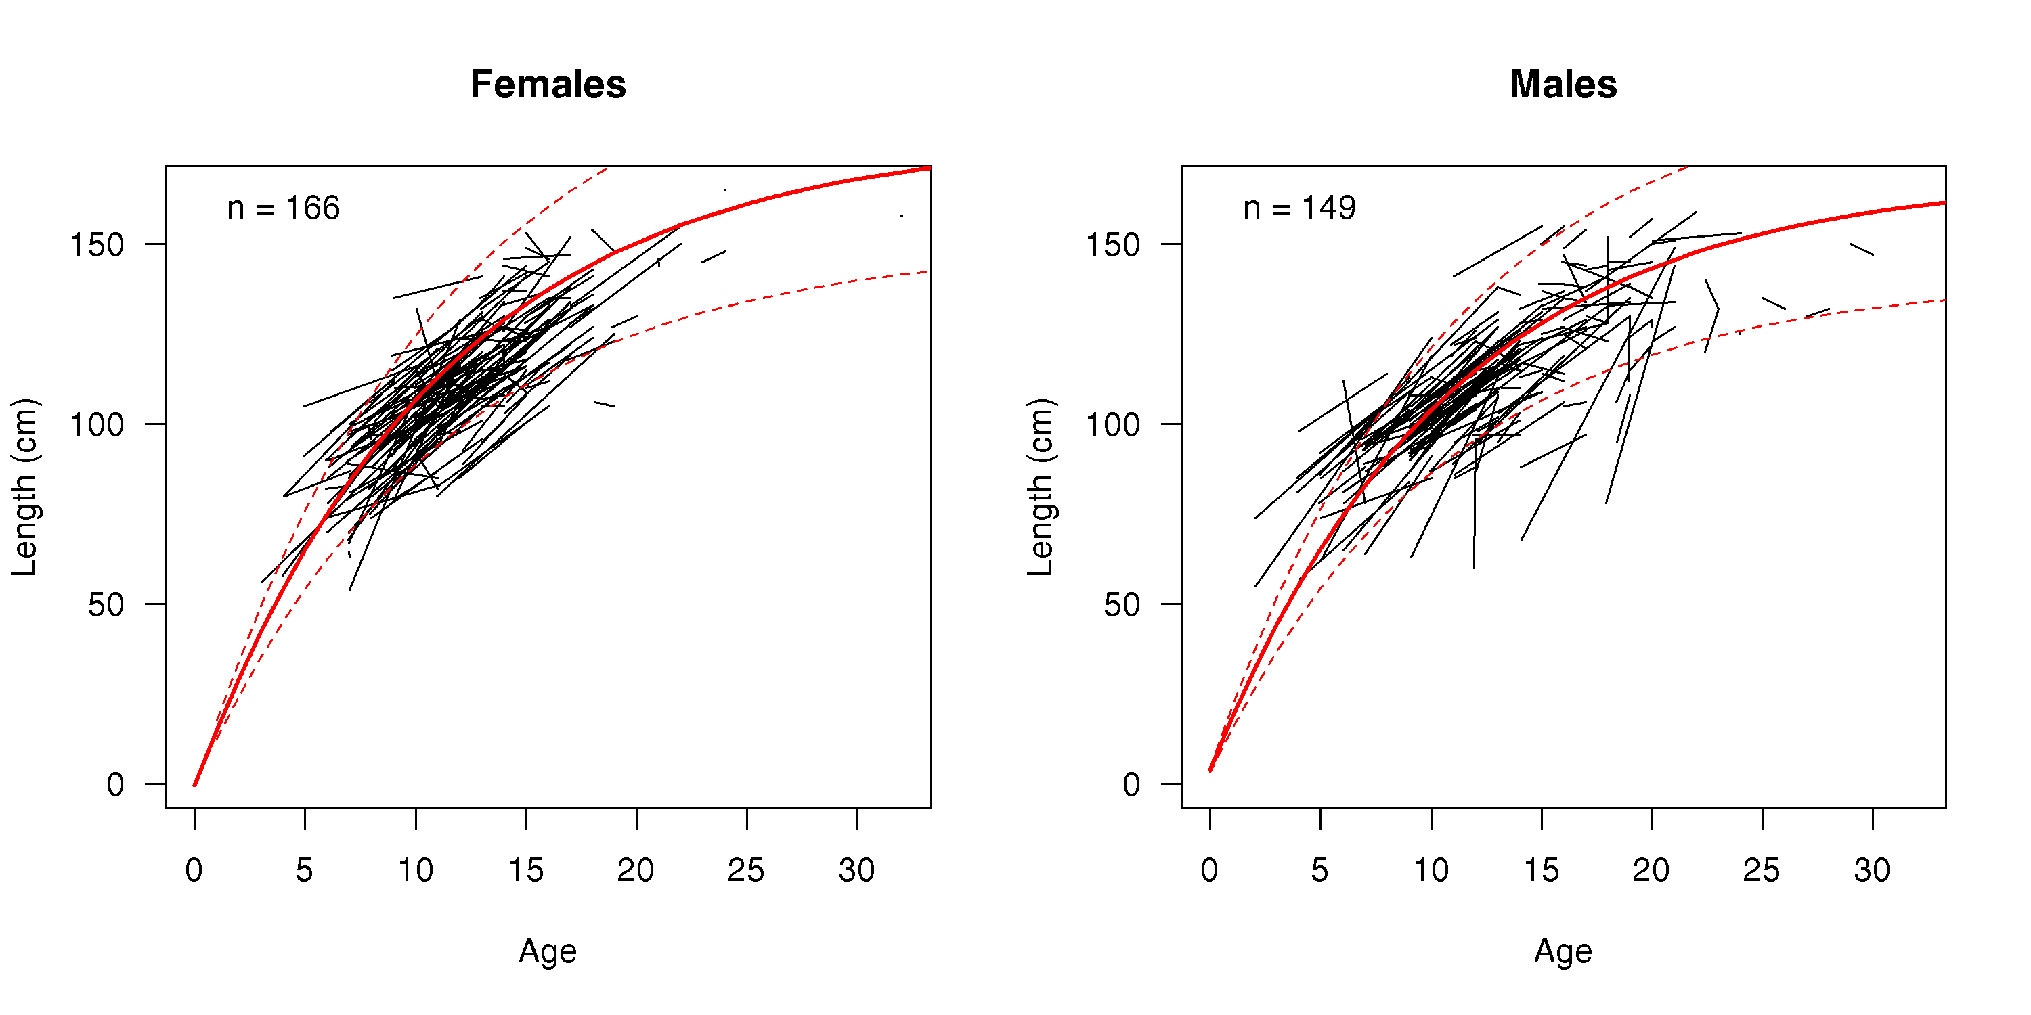
Tag-recapture-age data
Notes:
From A Dunn, P Horn, S Hanchet WG-FSA-SAM-06/8 (2006). Revised estimates of the biological parameters for Antarctic toothfish (Dissostichus mawsoni) in the Ross Sea.

Slide 6
Individual variation
Variation among individuals can be studied by treating one or more of each individual’s demographic parameters as a random-effect that arises from a population-level distribution
Random-effects form a probability distribution

Slide 7
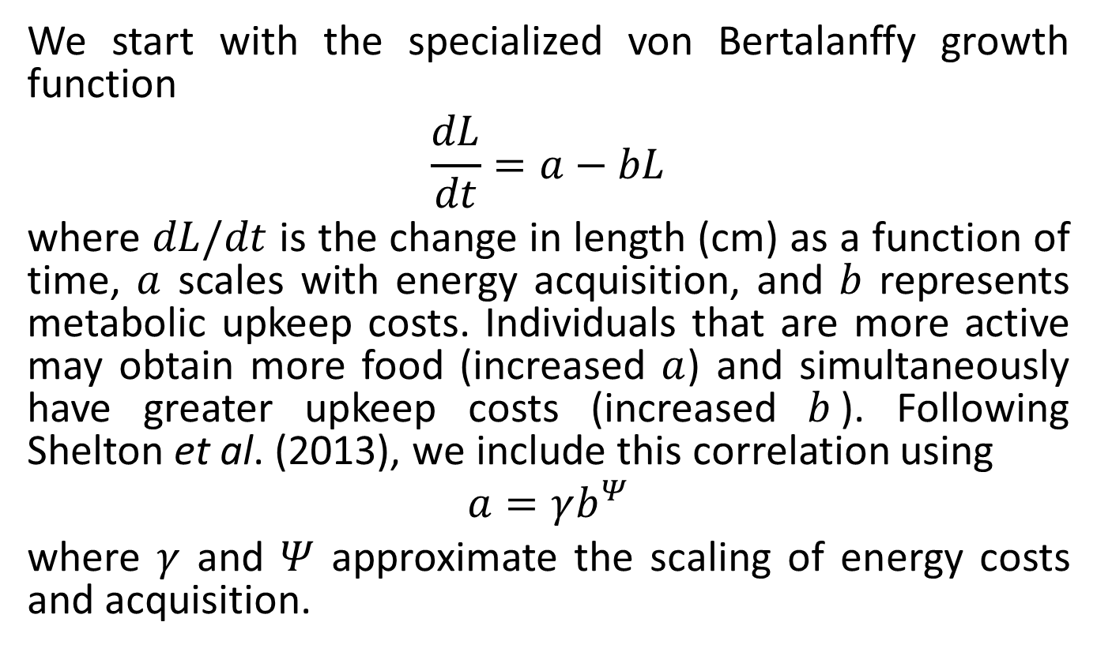
Individual variation
We start with the specialized von Bertalanffy growth function
$$\frac{dL}{dt}=a−bL$$
where $dL/dt$ is the change in length (cm) as a function of time, $a$ scales with energy acquisition, and $b$ represents metabolic upkeep costs. Individuals that are more active may obtain more food (increased $a$) and simultaneously have greater upkeep costs (increased $b$). Following Shelton et al. (2013), we include this correlation using
$$a=γb^{Ψ}$$
where $γ$ and $Ψ$ approximate the scaling of energy costs and acquisition.

Slide 8
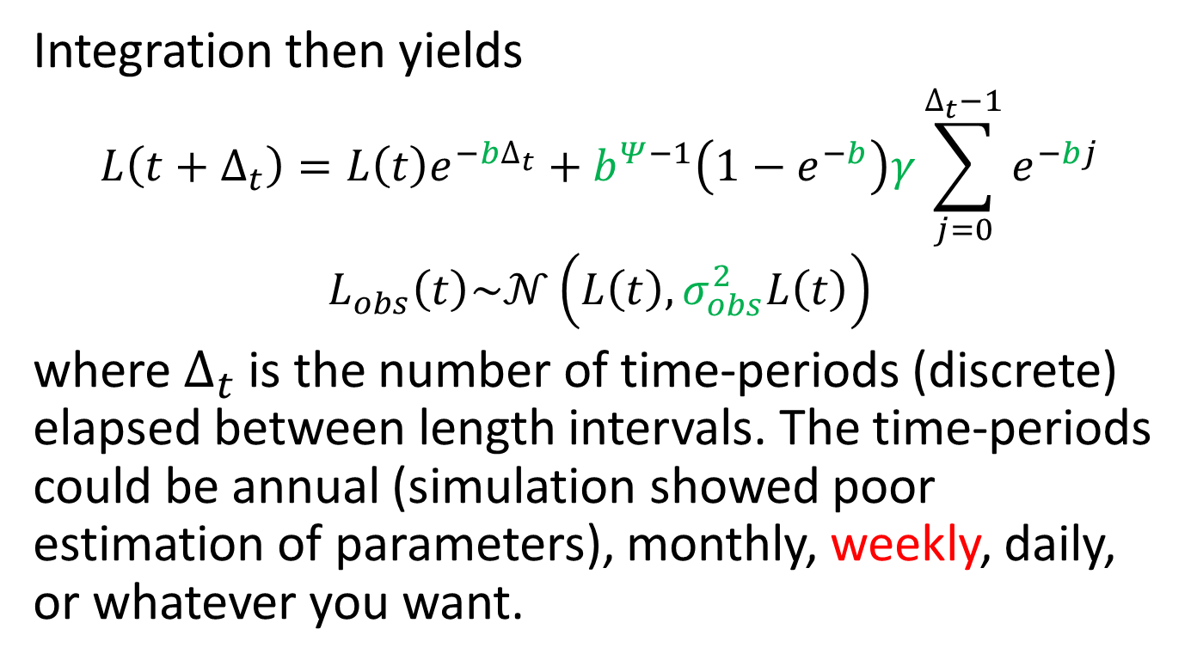
Individual variation
Integration then yields
$$L\left(t+∆_{t}\right)=L\left(t\right)e^{−b∆_{t}}+b^{Ψ−1}\left(1−e^{−b}\right)γ\sum_{j=0}^{∆_{t}−1}{e^{−bj}}$$
$$L_{obs}\left(t\right)\sim 𝒩\left(L\left(t\right),σ_{obs}^{2}L\left(t\right)\right)$$
where $∆_{t}$ is the number of time-periods (discrete) elapsed between length intervals. The time-periods could be annual (simulation showed poor estimation of parameters), monthly, weekly, daily, or whatever you want.

Slide 9
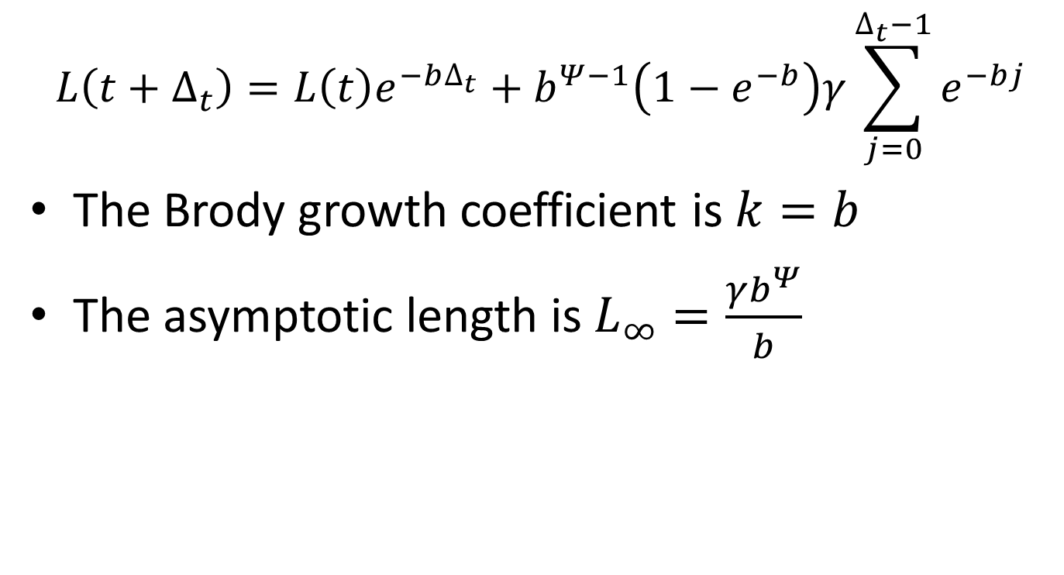
Relationship to conventional von Bertalanffy
$$L\left(t+∆_{t}\right)=L\left(t\right)e^{−b∆_{t}}+b^{Ψ−1}\left(1−e^{−b}\right)γ\sum_{j=0}^{∆_{t}−1}{e^{−bj}}$$
The Brody growth coefficient is $k=b$
The asymptotic length is $L_{∞}=\frac{γb^{Ψ}}{b}$

Slide 10
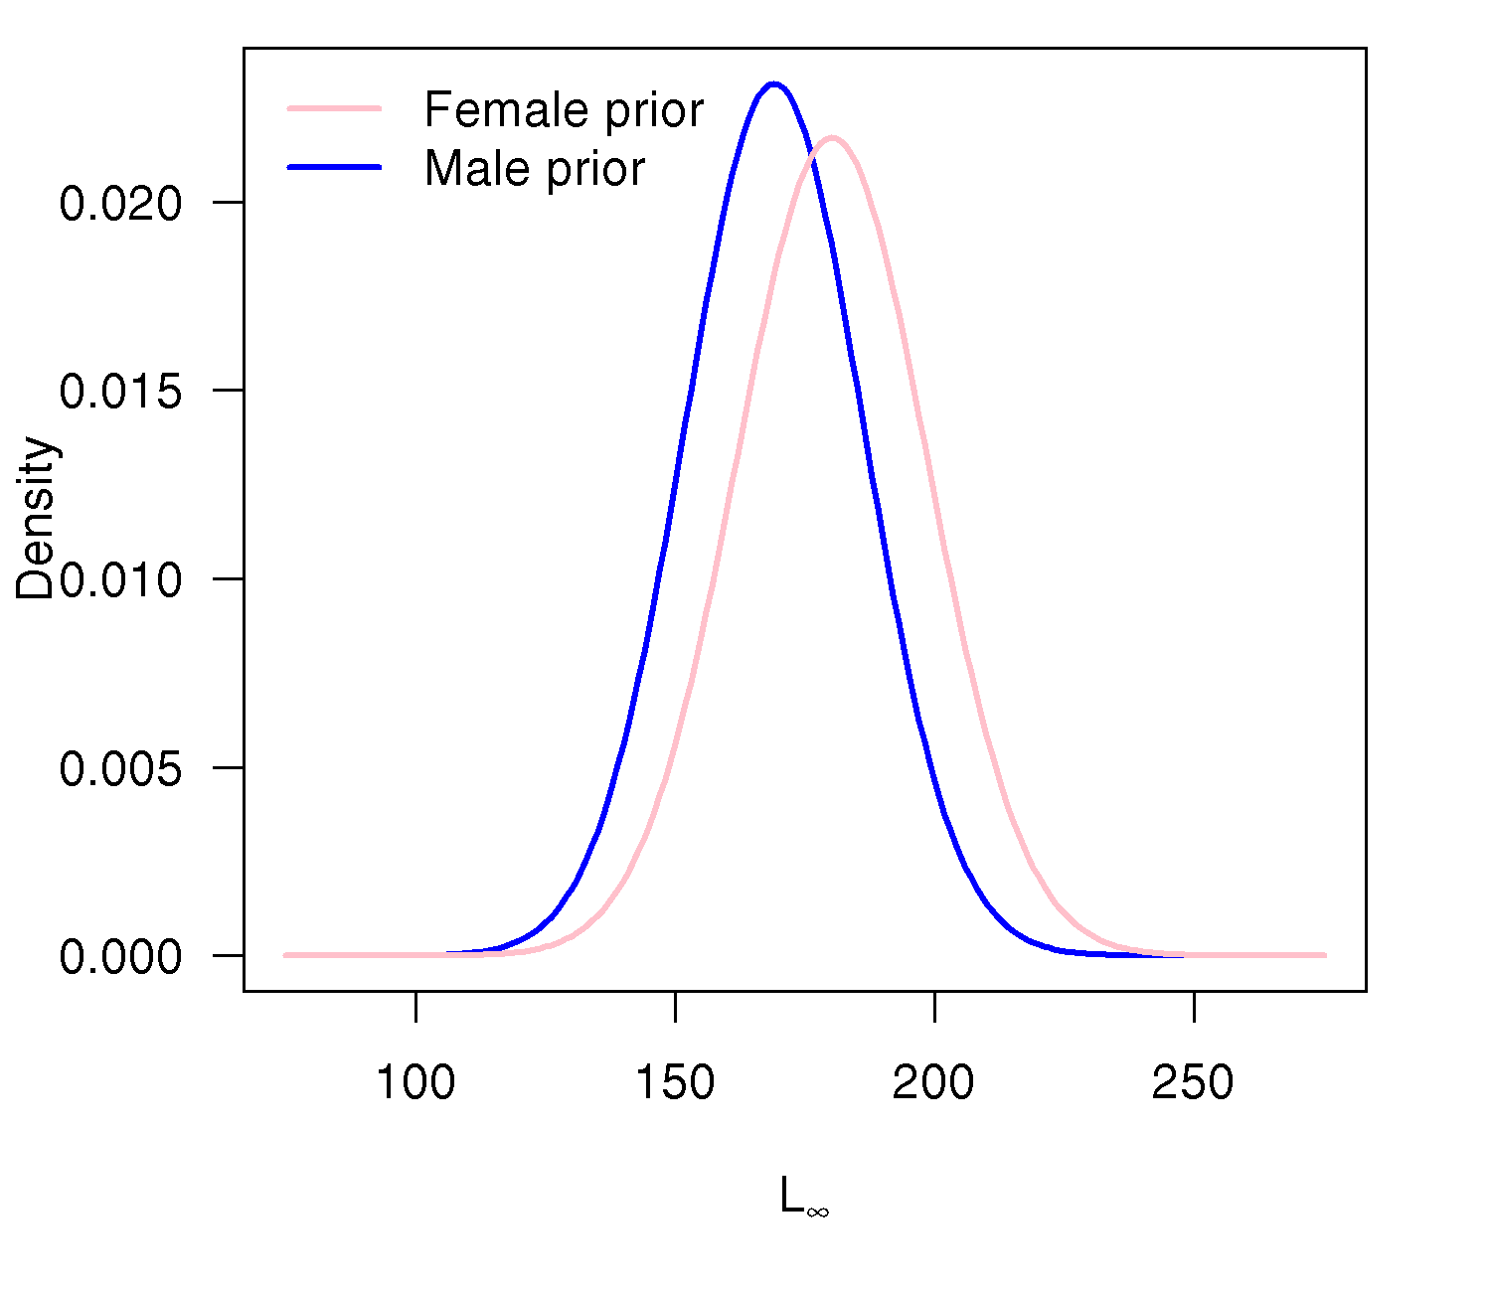
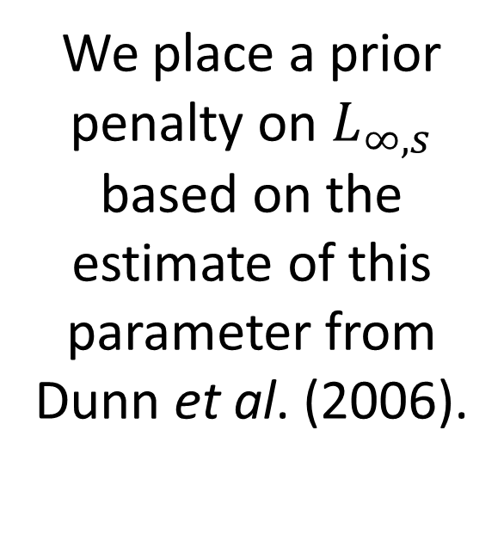
Prior penalty
We place a prior penalty on $L_{∞,s}$ based on the estimate of this parameter from Dunn et al. (2006).
Notes:
We can place prior penalties on parameters, analogous to priors in Bayesian models.
In this model we found that we needed to place a prior penalty on L infinity as the data for larger fish is lacking a bit.

Slide 11
Fitting the model
Mixed-effects model – some parameters estimated as fixed-effects, some as random-effects
Maximum marginal likelihood avoids the need to specify priors (but we do need to specify type of distribution for random-effects and prior penalties if desired)
Effects are estimated via shrinkage
We implement the model using Template Model Builder (TMB) from within R using the TMB package

Slide 12
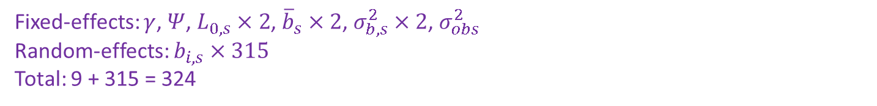
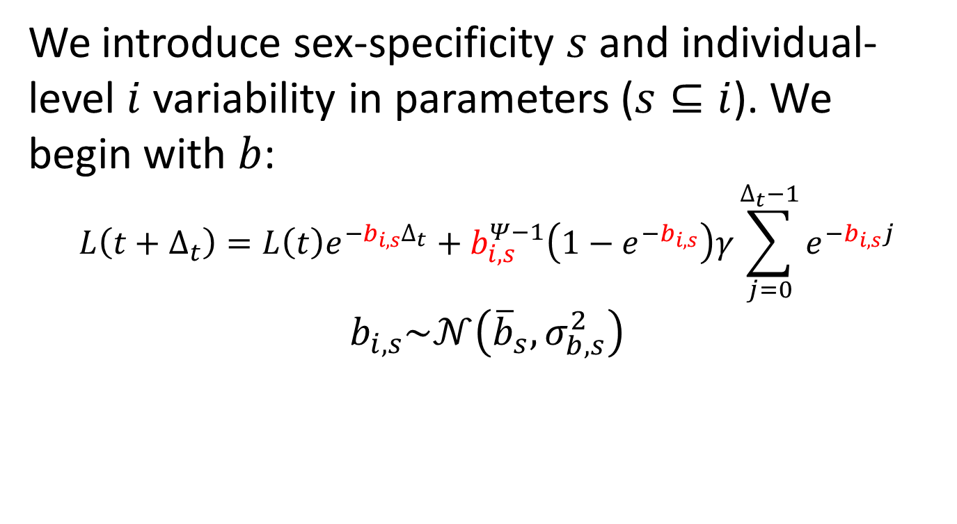
Individual variation
We introduce sex-specificity $s$ and individual-level $i$ variability in parameters ($s⊆i$). We begin with $b$:
$$L\left(t+∆_{t}\right)=L\left(t\right)e^{−b_{i,s}∆_{t}}+b_{i,s}^{Ψ−1}\left(1−e^{−b_{i,s}}\right)γ\sum_{j=0}^{∆_{t}−1}{e^{−b_{i,s}j}}$$
$$b_{i,s}\sim 𝒩\left({\overline{b}}_{s},σ_{b,s}^{2}\right)$$
Fixed-effects: $γ$, $Ψ$, $L_{0,s}×2$, ${\overline{b}}_{s}×2$, $σ_{b,s}^{2}×2$, $σ_{obs}^{2}$
Random-effects: $b_{i,s}×315$
Total: 9 + 315 = 324

Slide 13
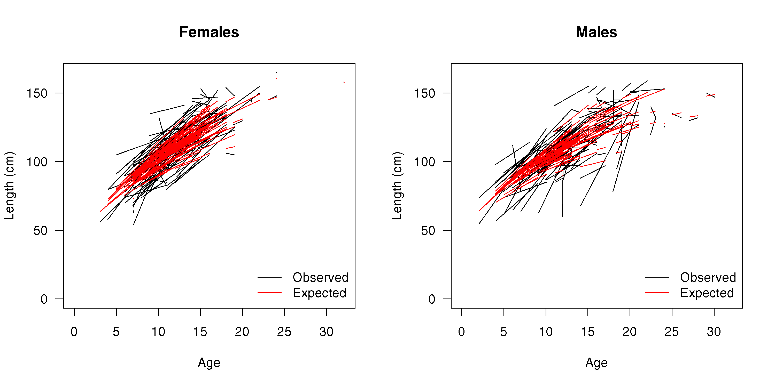
Individual variation

Slide 14
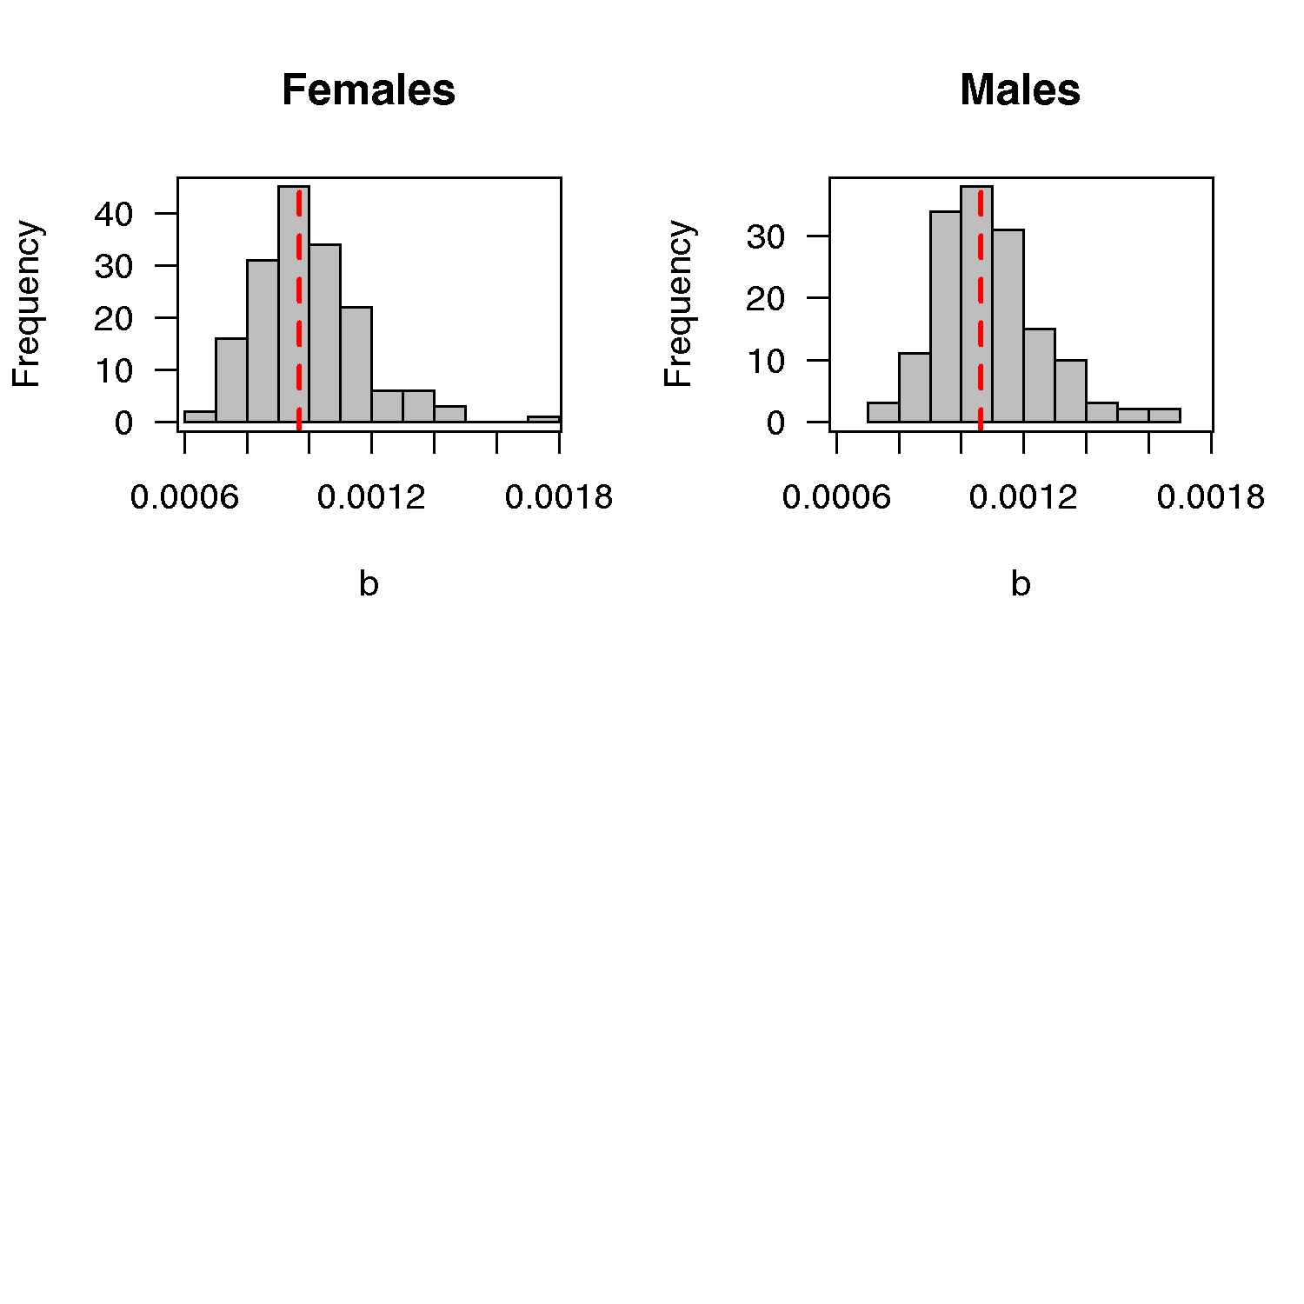
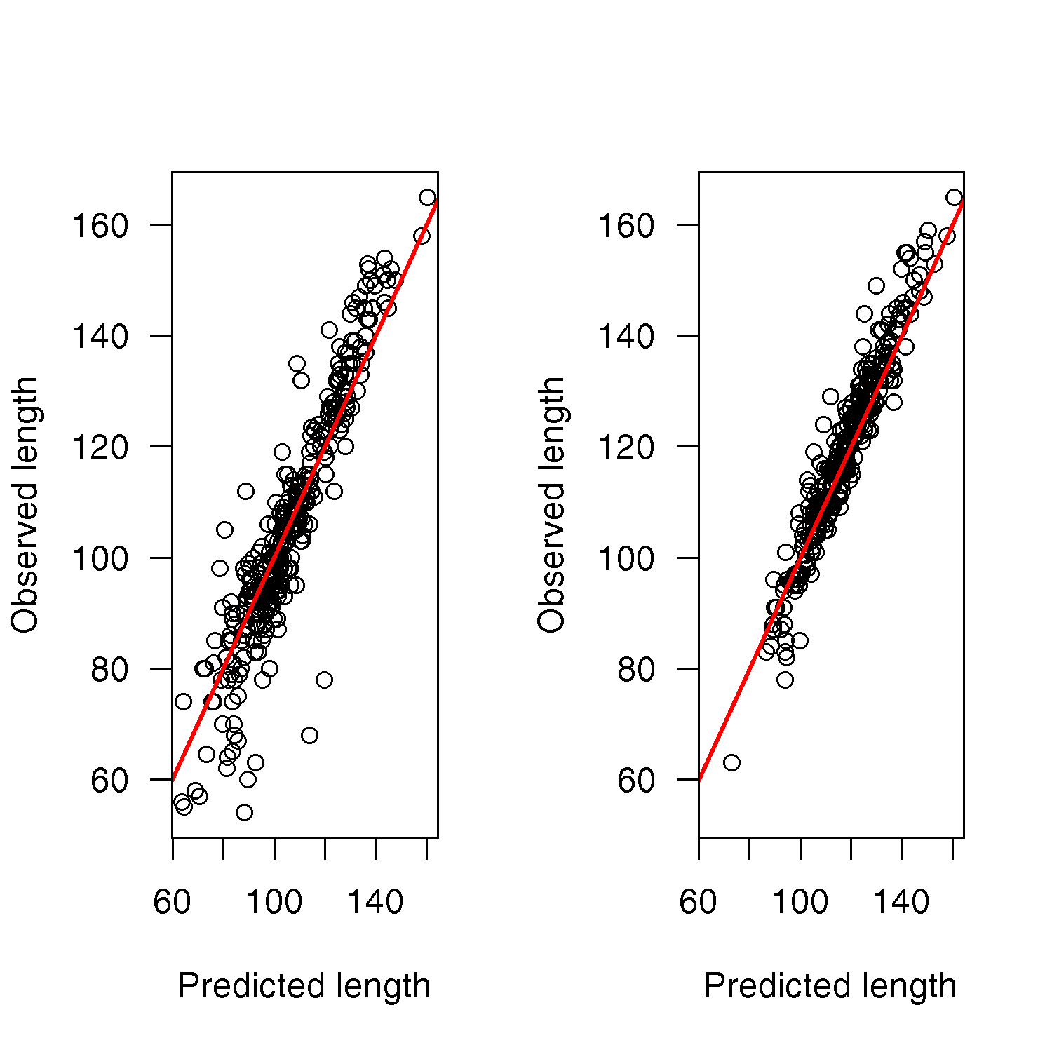
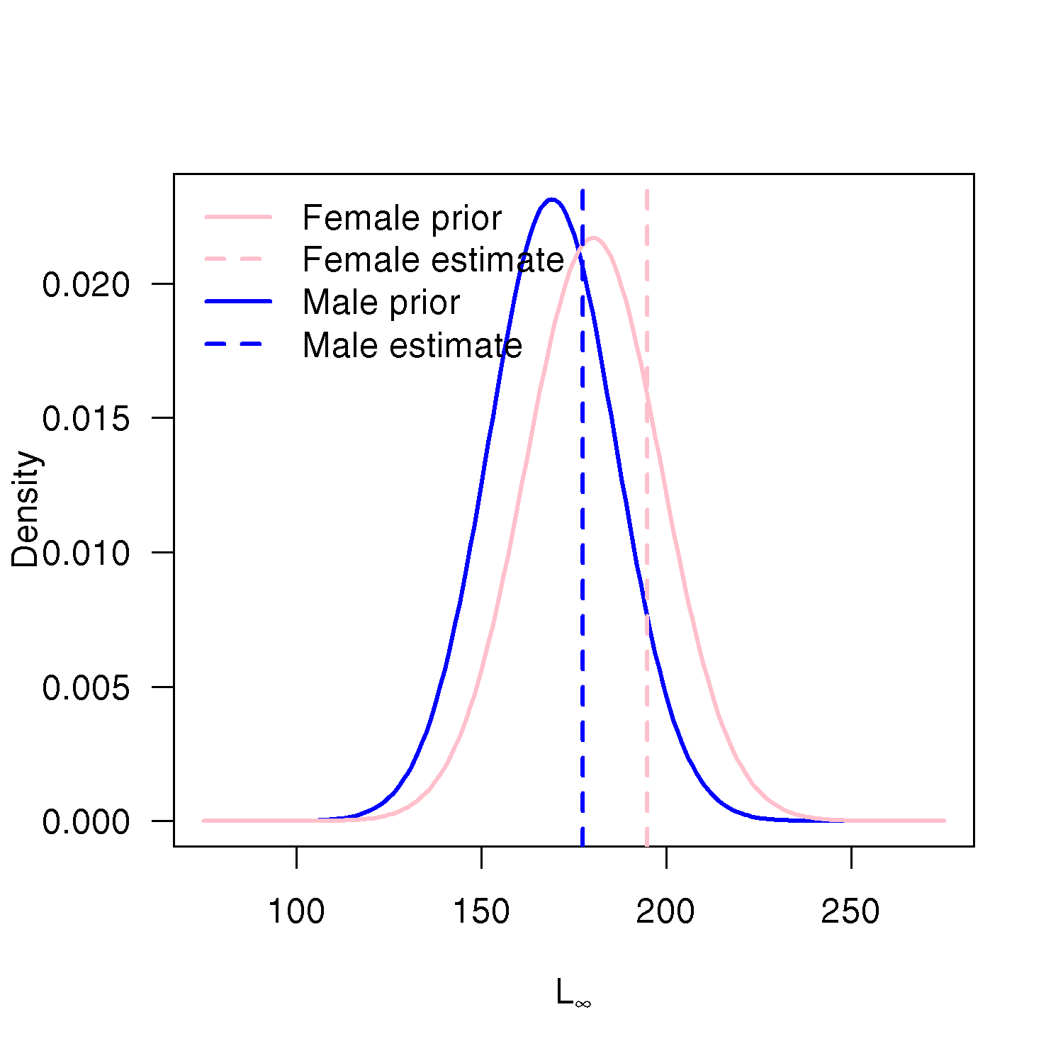

Slide 15
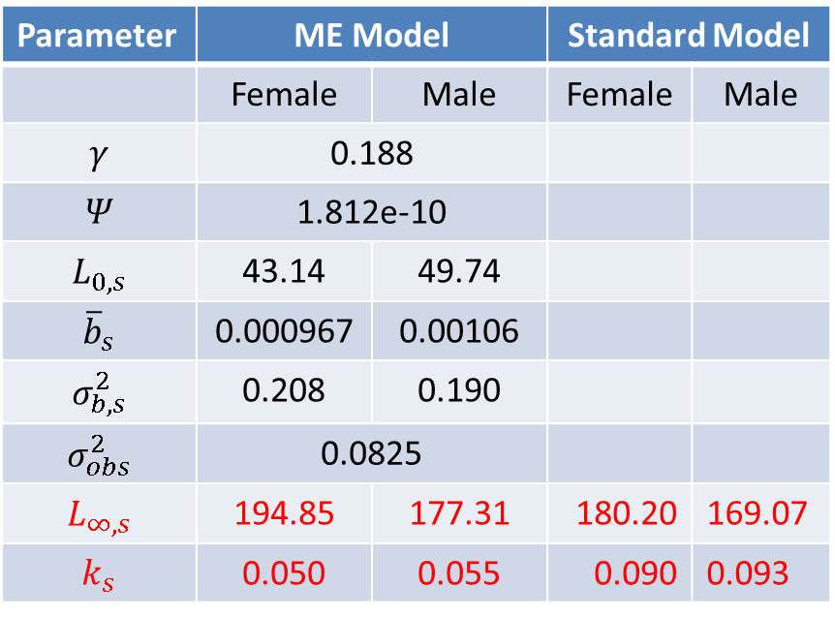
Individual variation
Parameter | ME Model |  | Standard Model
 | Female | Male | Female | Male
$$γ$$ | 0.188
$$Ψ$$ | 1.812e-10
$$L_{0,s}$$ | 43.14 | 49.74
$${\overline{b}}_{s}$$ | 0.000967 | 0.00106
$$σ_{b,s}^{2}$$ | 0.208 | 0.190
$$σ_{obs}^{2}$$ | 0.0825
$$L_{∞,s}$$ | 194.85 | 177.31 | 180.20 | 169.07
$$k_{s}$$ | 0.050 | 0.055 | 0.090 | 0.093

Slide 16
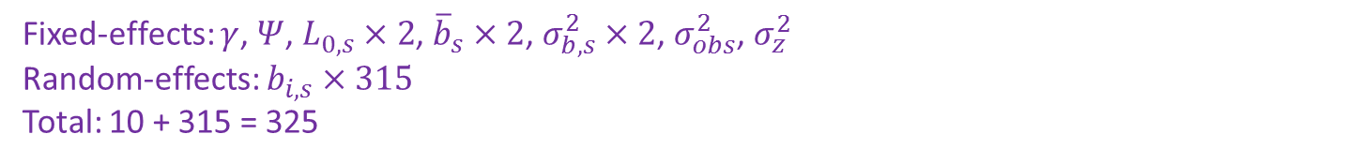
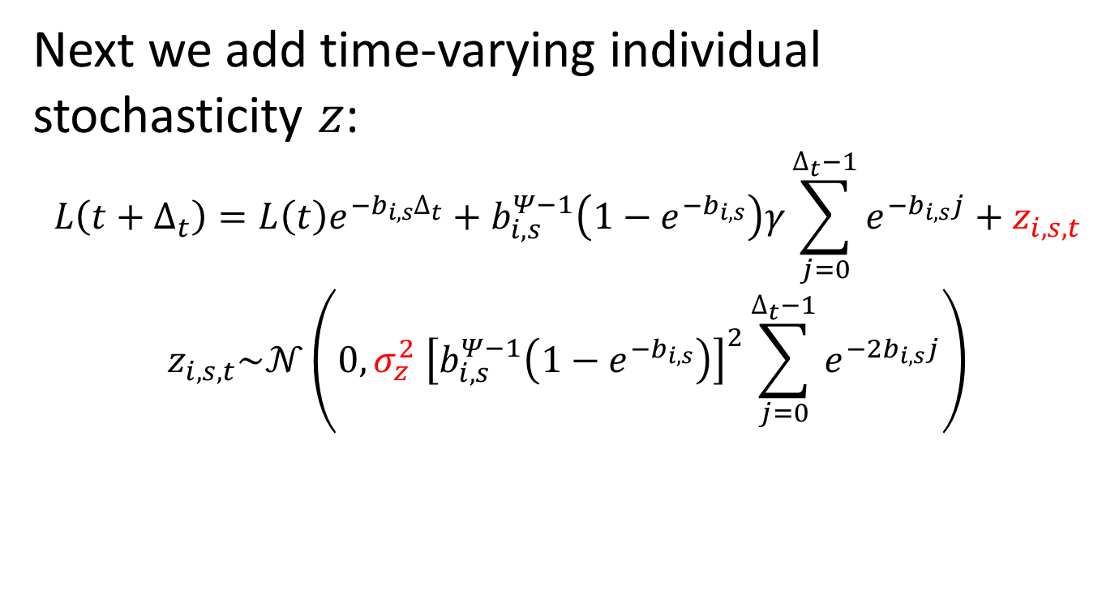
Individual variation
Next we add time-varying individual stochasticity $z$:
$$L\left(t+∆_{t}\right)=L\left(t\right)e^{−b_{i,s}∆_{t}}+b_{i,s}^{Ψ−1}\left(1−e^{−b_{i,s}}\right)γ\sum_{j=0}^{∆_{t}−1}{e^{−b_{i,s}j}}+z_{i,s,t}$$
$$z_{i,s,t}\sim 𝒩\left(0,σ_{z}^{2} {\left[b_{i,s}^{Ψ−1}\left(1−e^{−b_{i,s}}\right)\right]}^{2}\sum_{j=0}^{∆_{t}−1}{e^{−2b_{i,s}j}}\right)$$
Fixed-effects: $γ$, $Ψ$, $L_{0,s}×2$, ${\overline{b}}_{s}×2$, $σ_{b,s}^{2}×2$, $σ_{obs}^{2}$, $σ_{z}^{2}$
Random-effects: $b_{i,s}×315$
Total: 10 + 315 = 325

Slide 17

Individual variation

Slide 18
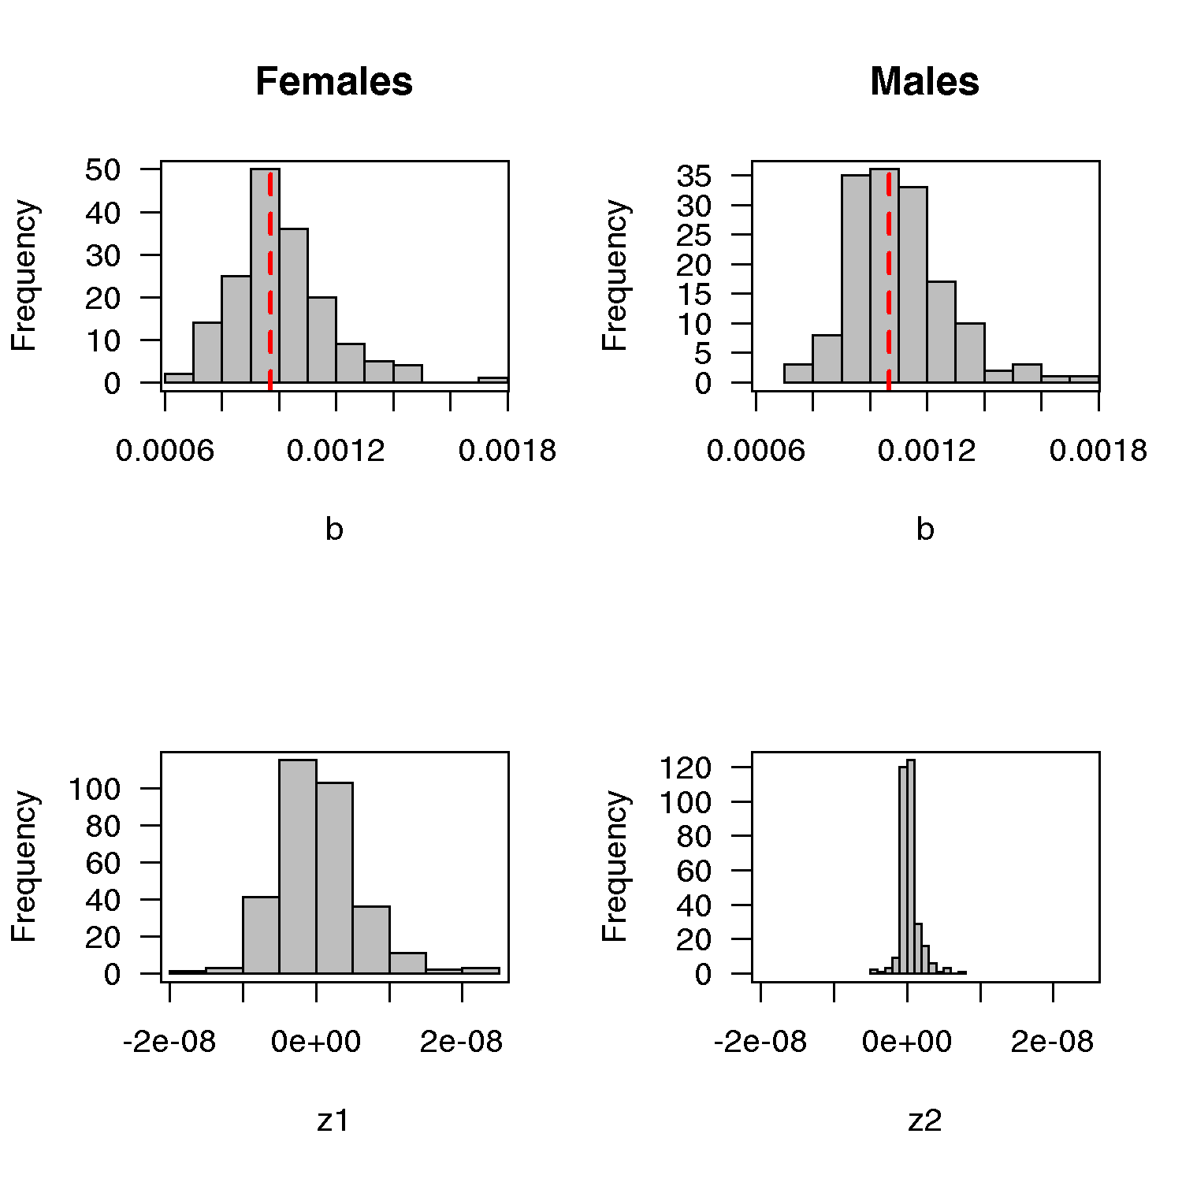
Individual variation

Slide 19
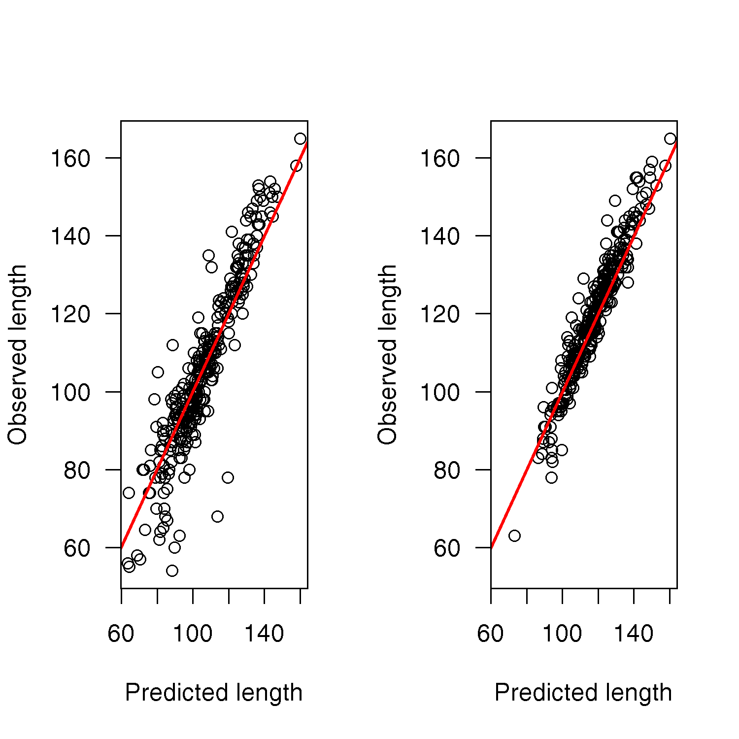

Individual variation

Slide 20
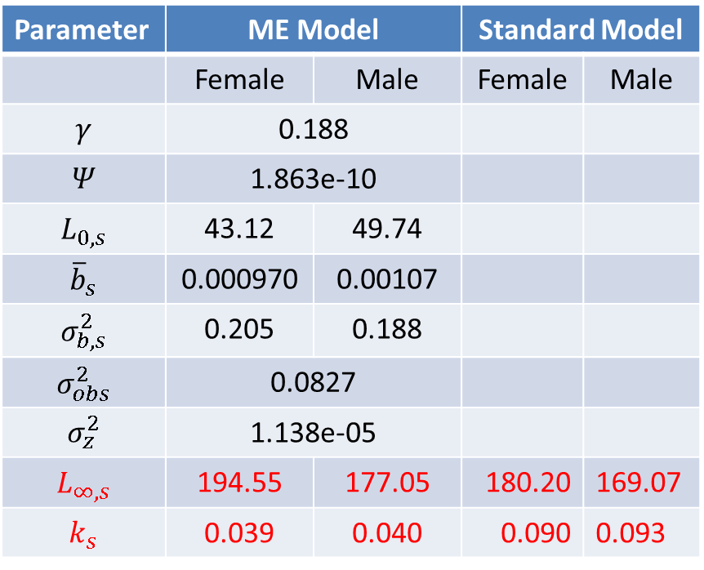
Individual variation
Parameter | ME Model |  | Standard Model
 | Female | Male | Female | Male
$$γ$$ | 0.188
$$Ψ$$ | 1.863e-10
$$L_{0,s}$$ | 43.12 | 49.74
$${\overline{b}}_{s}$$ | 0.000970 | 0.00107
$$σ_{b,s}^{2}$$ | 0.205 | 0.188
$$σ_{obs}^{2}$$ | 0.0827
$$σ_{z}^{2}$$ | 1.138e-05
$$L_{∞,s}$$ | 194.55 | 177.05 | 180.20 | 169.07
$$k_{s}$$ | 0.039 | 0.040 | 0.090 | 0.093

Slide 21
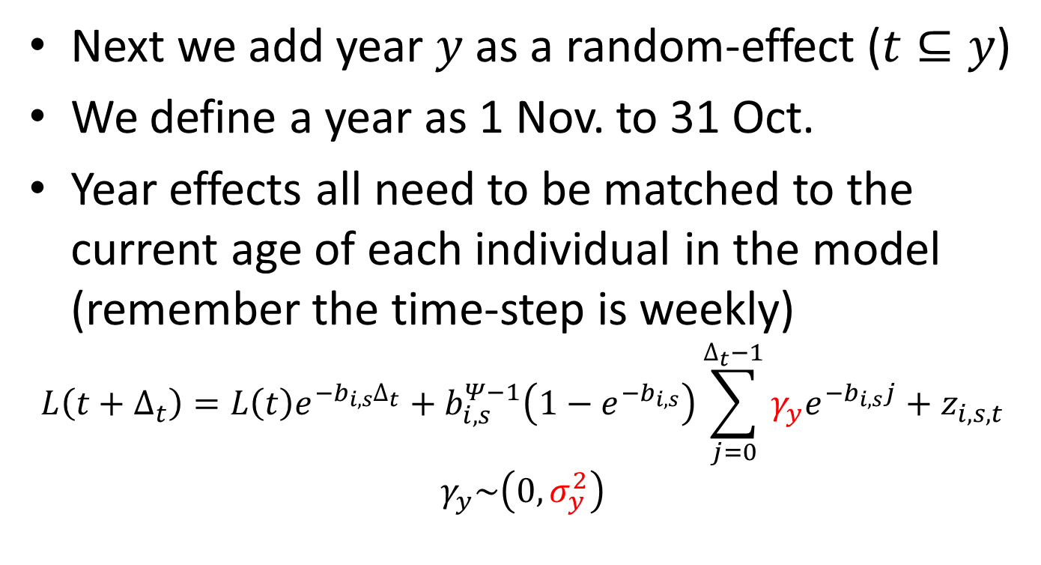
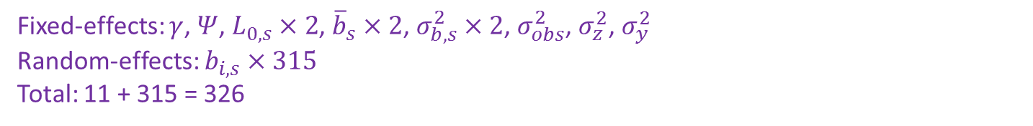
Annual variability
Next we add year $y$ as a random-effect ($t⊆y$)
We define a year as 1 Nov. to 31 Oct.
Year effects all need to be matched to the current age of each individual in the model (remember the time-step is weekly)
$$L\left(t+∆_{t}\right)=L\left(t\right)e^{−b_{i,s}∆_{t}}+b_{i,s}^{Ψ−1}\left(1−e^{−b_{i,s}}\right)\sum_{j=0}^{∆_{t}−1}{γ_{y}e^{−b_{i,s}j}}+z_{i,s,t}$$
$$γ_{y}\sim \left(0,σ_{y}^{2}\right)$$
Fixed-effects: $γ$, $Ψ$, $L_{0,s}×2$, ${\overline{b}}_{s}×2$, $σ_{b,s}^{2}×2$, $σ_{obs}^{2}$, $σ_{z}^{2}$, $σ_{y}^{2}$
Random-effects: $b_{i,s}×315$
Total: 11 + 315 = 326
Notes:
Define the first year and last year in the model. The earliest birth date of a fish was "1973-01-09" (R format) and the latest record we have was "2012-01-28" so our years would be "1 Nov 1972 to 31 Oct 1973" through to "1 Nov 2011 to 31 Oct 2012" giving us 40 annual deviation parameters. In the model these would simply be y_dev 0 to 39.

Slide 22
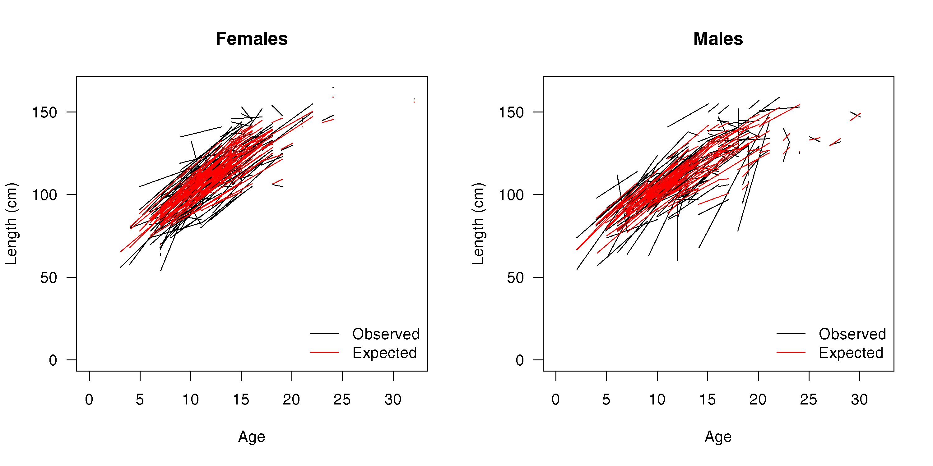
Annual variability
Notes:
Define the first year and last year in the model. The earliest birth date of a fish was "1973-01-09" (R format) and the latest record we have was "2012-01-28" so our years would be "1 Nov 1972 to 31 Oct 1973" through to "1 Nov 2011 to 31 Oct 2012" giving us 40 annual deviation parameters. In the model these would simply be y_dev 0 to 39.

Slide 23
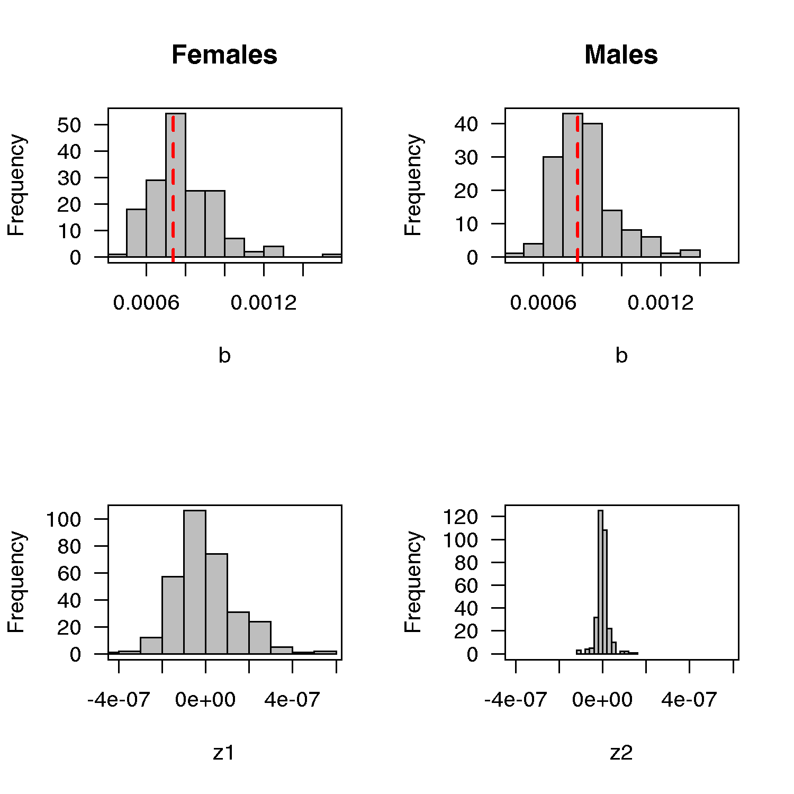
Annual variability

Slide 24
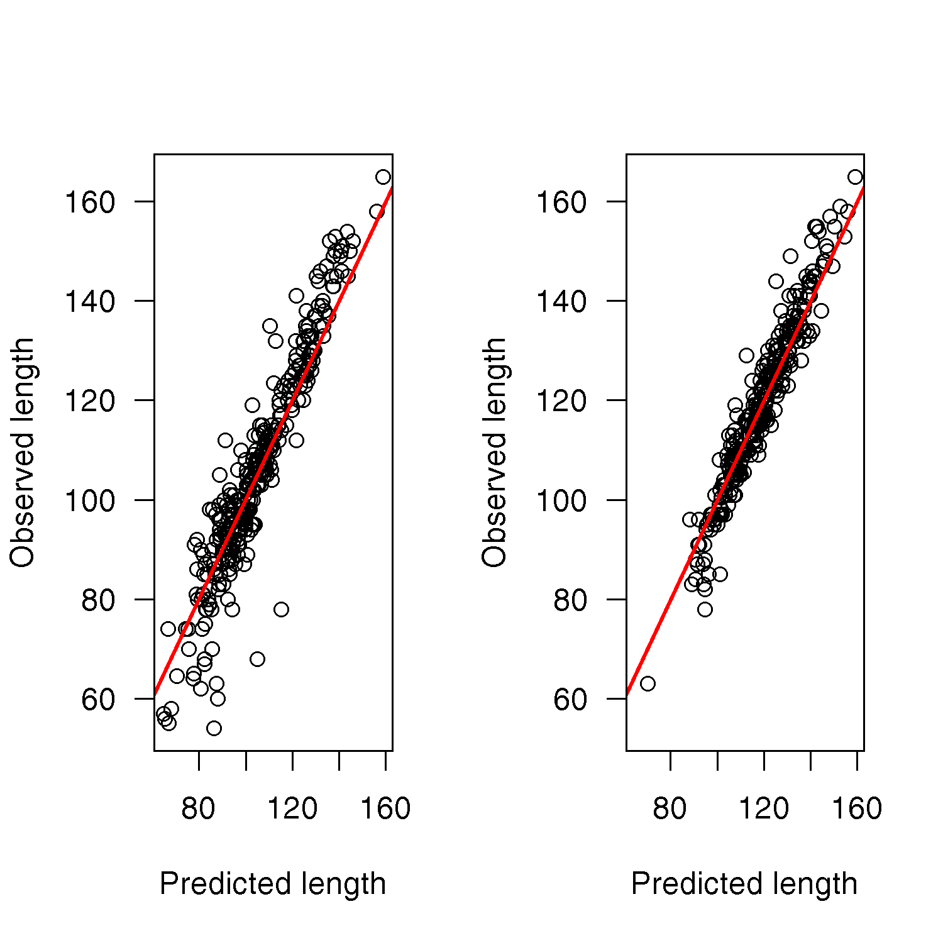
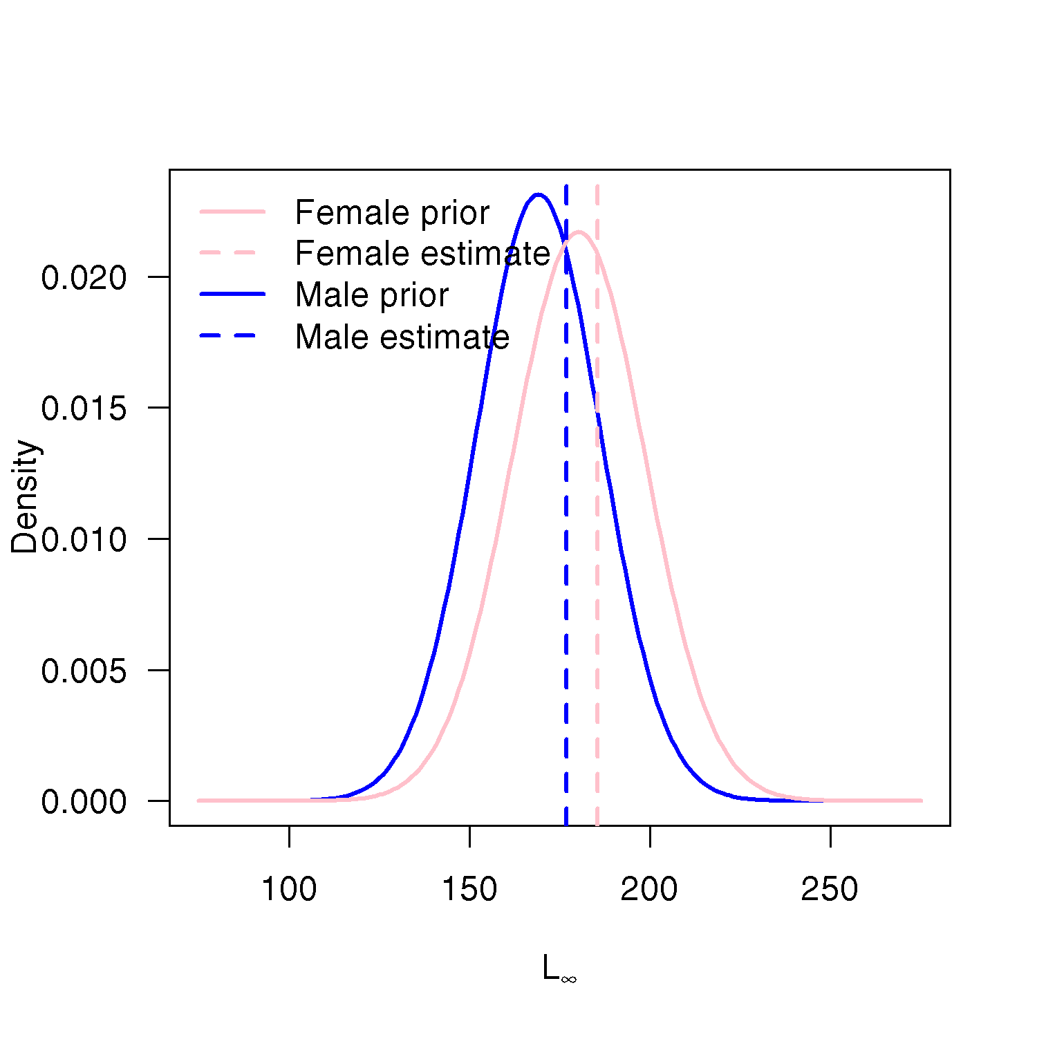
Annual variability

Slide 25
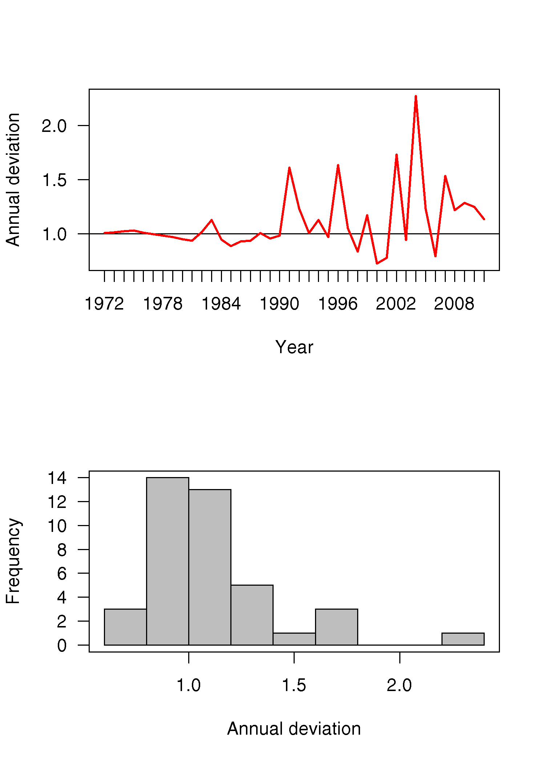
Annual variability

Slide 26
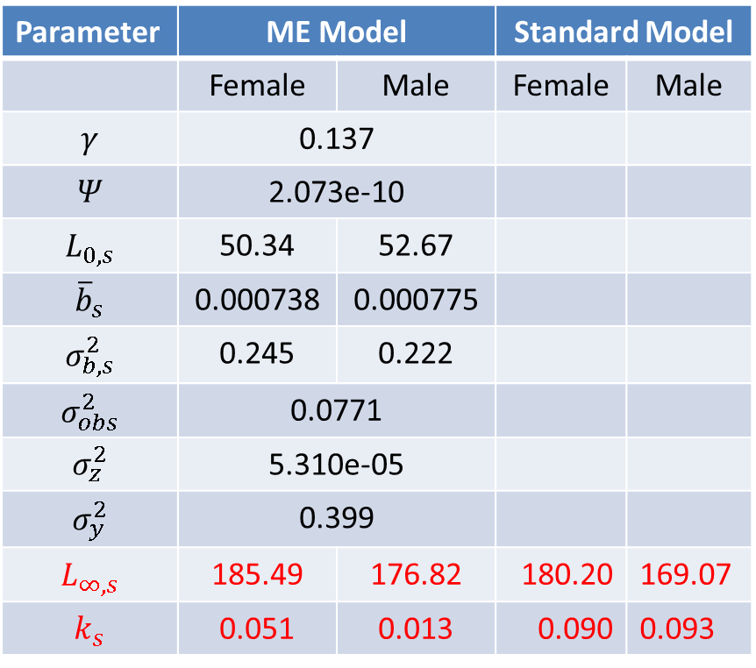
Annual variability
Parameter | ME Model |  | Standard Model
 | Female | Male | Female | Male
$$γ$$ | 0.137
$$Ψ$$ | 2.073e-10
$$L_{0,s}$$ | 50.34 | 52.67
$${\overline{b}}_{s}$$ | 0.000738 | 0.000775
$$σ_{b,s}^{2}$$ | 0.245 | 0.222
$$σ_{obs}^{2}$$ | 0.0771
$$σ_{z}^{2}$$ | 5.310e-05
$$σ_{y}^{2}$$ | 0.399
$$L_{∞,s}$$ | 185.49 | 176.82 | 180.20 | 169.07
$$k_{s}$$ | 0.051 | 0.013 | 0.090 | 0.093

Slide 27
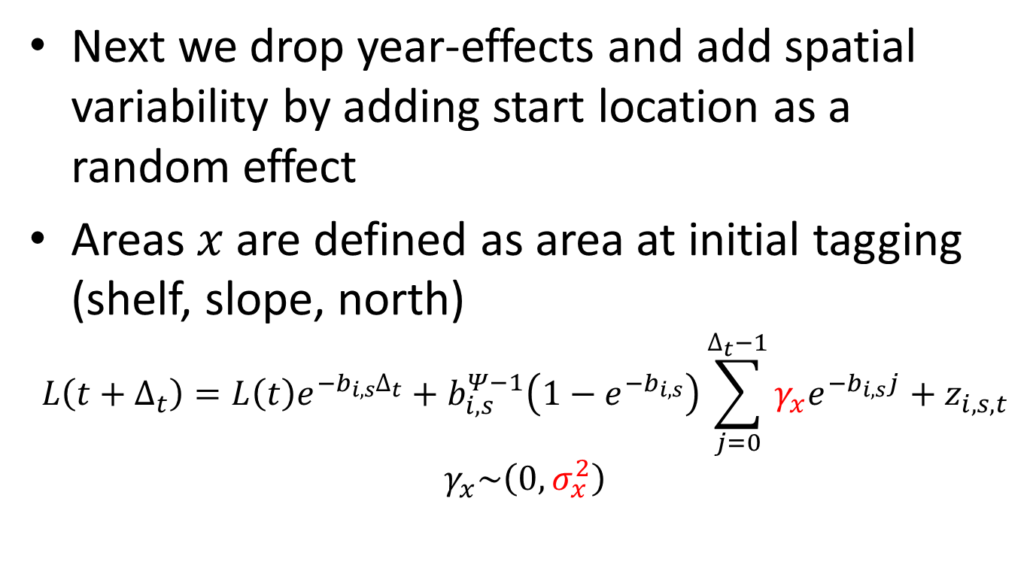

Spatial variability
Next we drop year-effects and add spatial variability by adding start location as a random effect
Areas $x$ are defined as area at initial tagging (shelf, slope, north)
$$L\left(t+∆_{t}\right)=L\left(t\right)e^{−b_{i,s}∆_{t}}+b_{i,s}^{Ψ−1}\left(1−e^{−b_{i,s}}\right)\sum_{j=0}^{∆_{t}−1}{γ_{x}e^{−b_{i,s}j}}+z_{i,s,t}$$
$$γ_{x}\sim \left(0,σ_{x}^{2}\right)$$
Fixed-effects: $γ$, $Ψ$, $L_{0,s}×2$, ${\overline{b}}_{s}×2$, $σ_{b,s}^{2}×2$, $σ_{obs}^{2}$, $σ_{z}^{2}$, $σ_{x}^{2}$
Random-effects: $b_{i,s}×315$
Total: 11 + 315 = 326

Slide 28
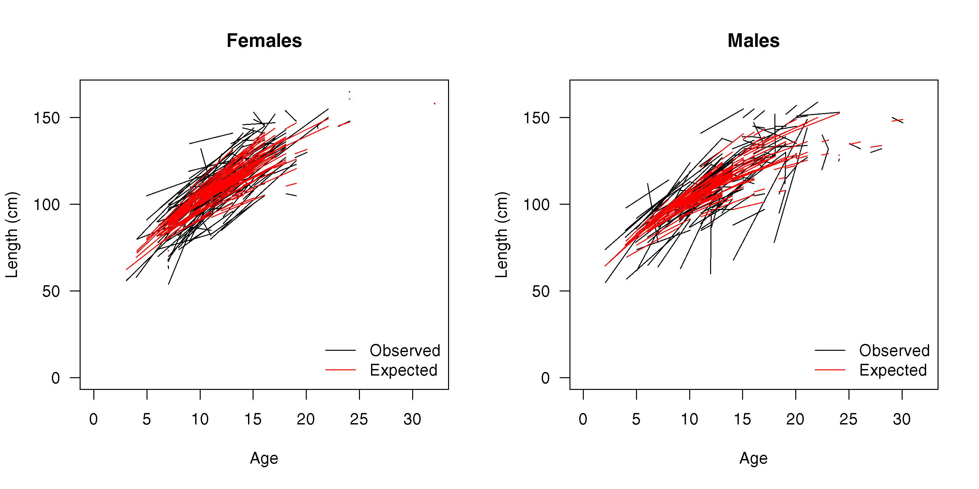
Spatial variability

Slide 29
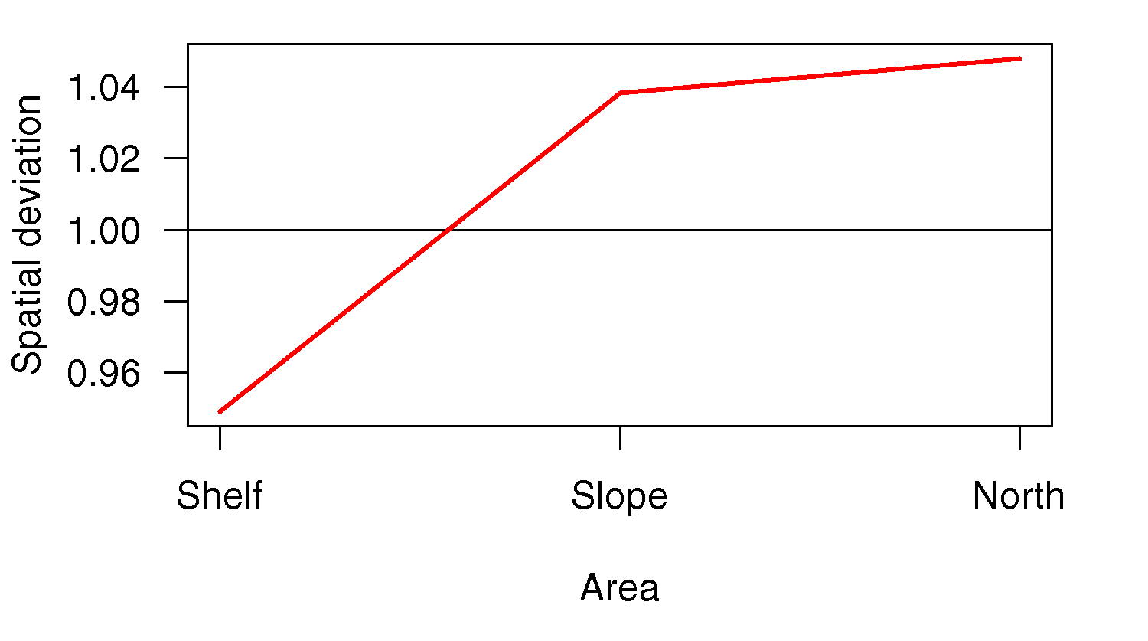
Spatial variability

Slide 30
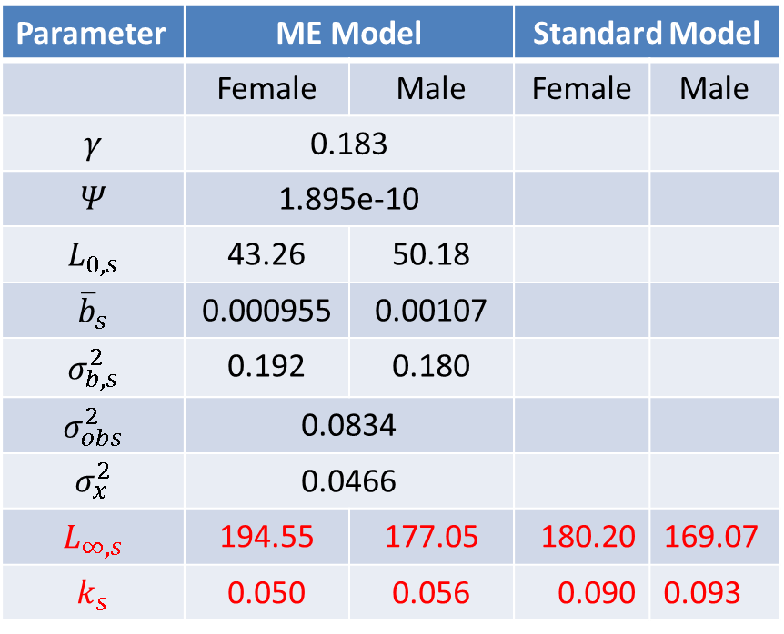
Spatial variability
Parameter | ME Model |  | Standard Model
 | Female | Male | Female | Male
$$γ$$ | 0.183
$$Ψ$$ | 1.895e-10
$$L_{0,s}$$ | 43.26 | 50.18
$${\overline{b}}_{s}$$ | 0.000955 | 0.00107
$$σ_{b,s}^{2}$$ | 0.192 | 0.180
$$σ_{obs}^{2}$$ | 0.0834
$$σ_{x}^{2}$$ | 0.0466
$$L_{∞,s}$$ | 194.55 | 177.05 | 180.20 | 169.07
$$k_{s}$$ | 0.050 | 0.056 | 0.090 | 0.093

Slide 31
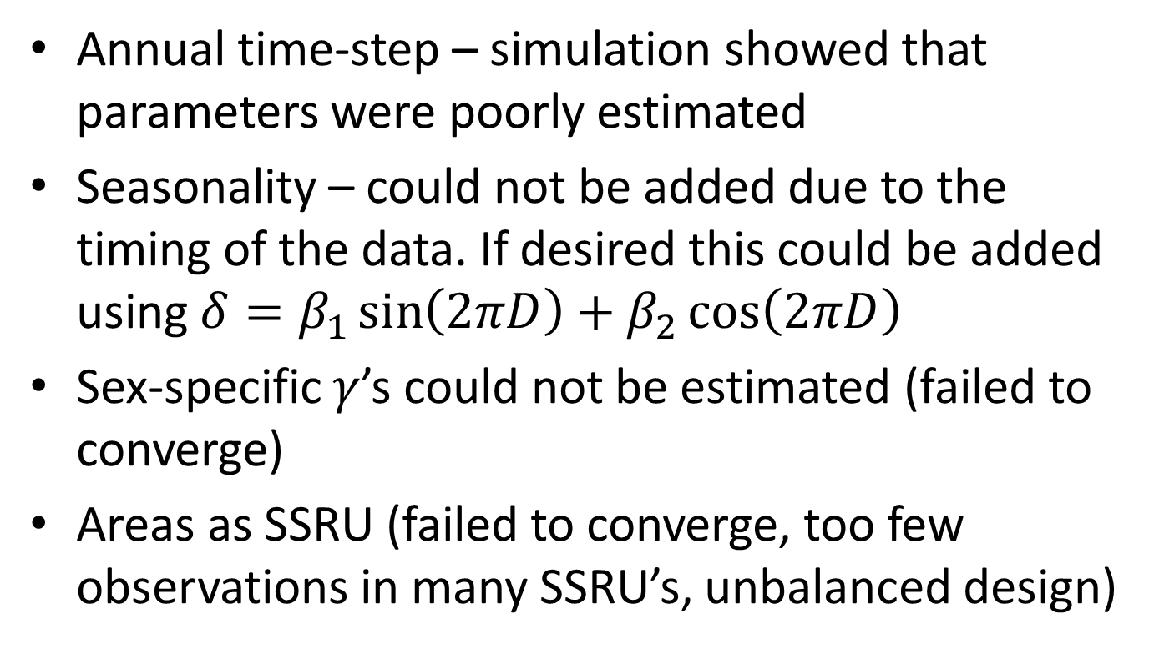
What did not work
Annual time-step – simulation showed that parameters were poorly estimated
Seasonality – could not be added due to the timing of the data. If desired this could be added using $δ=β_{1}\sin\left(2πD\right)+β_{2}\cos\left(2πD\right)$
Sex-specific $γ$’s could not be estimated (failed to converge)
Areas as SSRU (failed to converge, too few observations in many SSRU’s, unbalanced design)

Slide 32
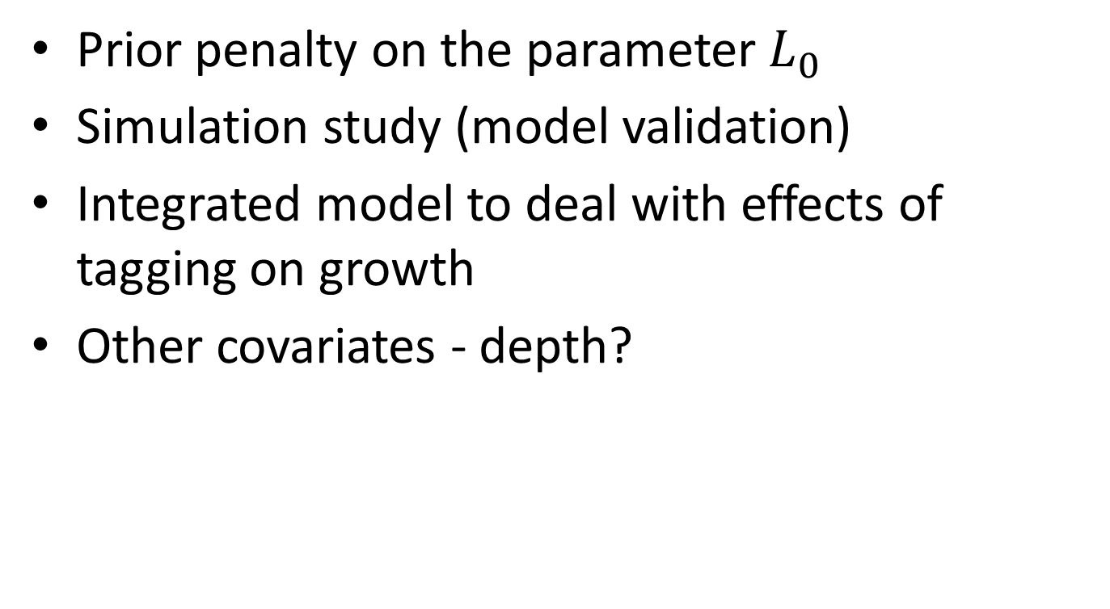
Further developments
Prior penalty on the parameter $L_{0}$
Simulation study (model validation)
Integrated model to deal with effects of tagging on growth
Other covariates - depth?

Slide 33
References
Dunn, A., Horn, P.L., and Hanchet, S.M. 2006. Revised estimates of the biological parameters for Antarctic toothfish (Dissostichus mawsoni) in the Ross Sea. CCAMLR, Hobart, Australia. WG-FSA-SAM-06/08: 1–14.
Shelton, A.O., Satterthwaite, W.H., Beakes, M.P., Munch, S.B., Sogard, S.M., and Mangel, M. 2013. Separating intrinsic and environmental contributions to growth and their population consequences. The American Naturalist 181: 799–814.

